Slide 1
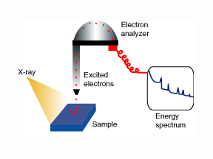
X-ray Photo electron spectroscopy(XPS)

Slide 2
XPS
It is a surface characterization technique that can analyze a sample to a depth of 2 to 5 nanometers (nm).
Kai Siegbahn developed XPS in the 1960s.
XPS reveals the chemical elements that are present at the surface and the nature of the chemical bond that exists between these elements.
It can detect all elements except hydrogen and helium.

Slide 3
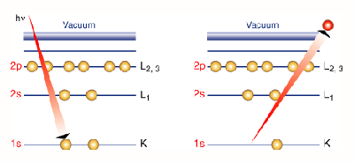
Photoemission principle
Ejection of electrons
When an x-ray bombards a sample, some electrons become excited and escape to the surface of the atom.

Slide 4
The other electrons undergo emission and suffer no energy loss in escaping the surface and into the surrounding vacuum.
Once these ejected electrons are in the vacuum,they are collected by an electron analyzer that measures the kinetic energy.
An electron analyzer produces an energy spectrum of intensity (no of ejected elctrons vs Time)verses binding energy(the energy the elctrons had before they left the atom).
Each prominent peak on the spectrum corresponds to a specific element.

Slide 5
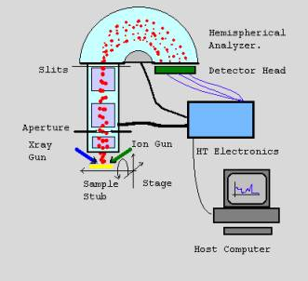
XPS Instrumentation

Slide 6
XPS is conducted in ultrahigh vacuum (UHV) conditions, around 10-9 millibar (mbar).
When X-rays are illuminated through the sample under study, it causes the ejection of electrons having different range of energies and directions.
These emitted electrons are collected by a set of electrostatic and or magnetic lens units and transferred through the apertures and focused onto the analyzer entrance slit.

Slide 7
Electrostatic fields within the hemispherical analyzer (HSA) are established in such a way that it allows electrons of a given energy (the so called Pass Energy PE) to arrive at the detector slits and onto the detectors for recording.

Slide 8
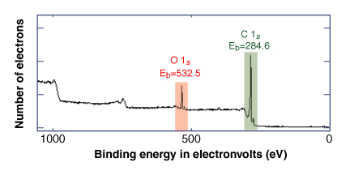
Spectrum
In the spectrum given above, there is a peak at 284.6 electron volts (eV), which corresponds to carbon, and a peak at 532.5 eV, which corresponds to oxygen. Therefore, we know that this sample contains carbon (C) and oxygen (O).

Slide 9
Spectrum
By applying relative sensitivity factors and appropriately integrating peak areas, it can be determined that the sample below is 25 percent oxygen and 75 percent carbon.
By studying the energy of the carbon peak, it can also be determined if the surface of this material corresponds to a C-O single bond (ethers, alcohols) or a much stronger C=O double bond (carboxylates, ketones).

Slide 10
Applications
XPS is primarily used for analysing the surface chemistry of a material.
Used to study the surface analysis of organic and inorganic materials.
To study the surface analysis of copper.
To study the fibre glass surfaces.
To study the thin film oxide thickness measurements.
Important analytical tool in wood adhesive research area.
Tool to probe electronic structures.

